Slide 1

TIME MANAGEMENT SYSTEM

Slide 2
Team
1. Bibhash Kumar (2019UGCS020R)
2. Rishav Kumar (2019UGCS058R)
3. Soumyabrata Bairagi (2019UGCS058R)
4. Aryan Singh (2019UGCS007R)

Slide 3
Project Scope
Efficient time management for its executives
Allows organizations to manage labor costs and increase productivity.

Slide 4
SRS

Slide 5
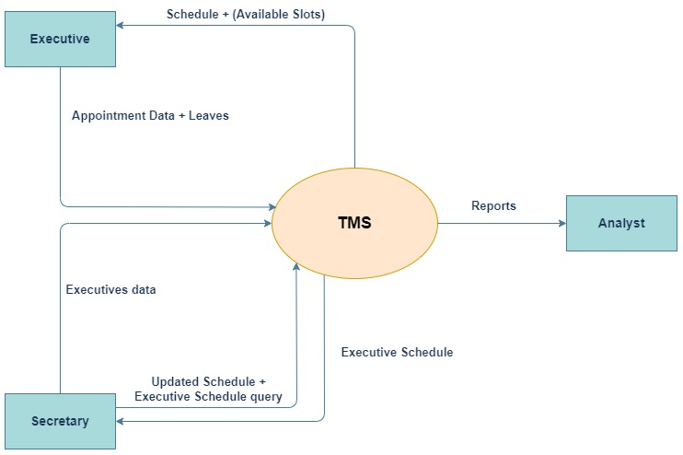
DFD Context Diagram (Level-0)

Slide 6
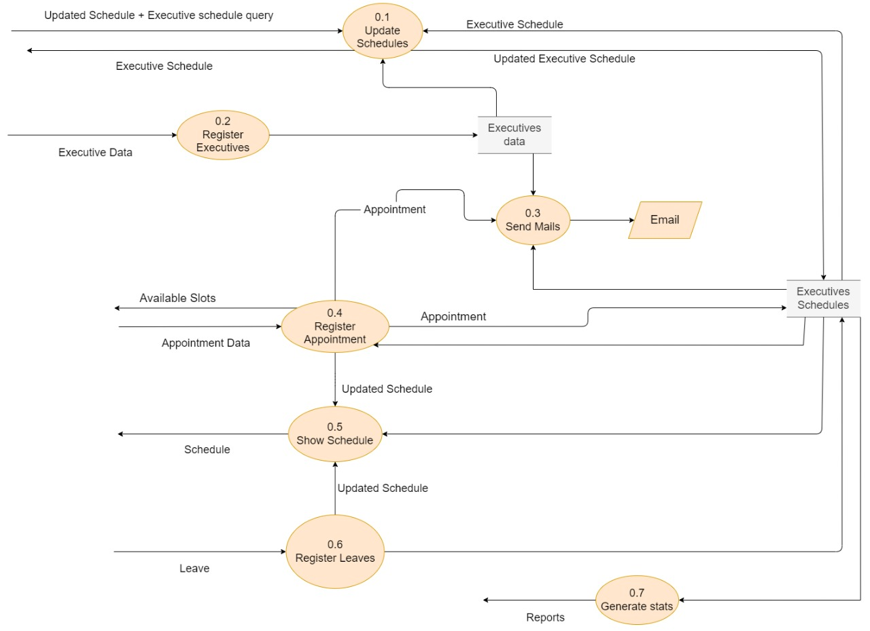
DFD Level-1

Slide 7
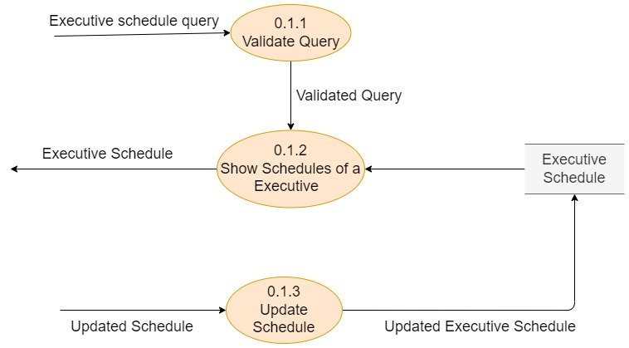
DFD Level-2

Slide 8
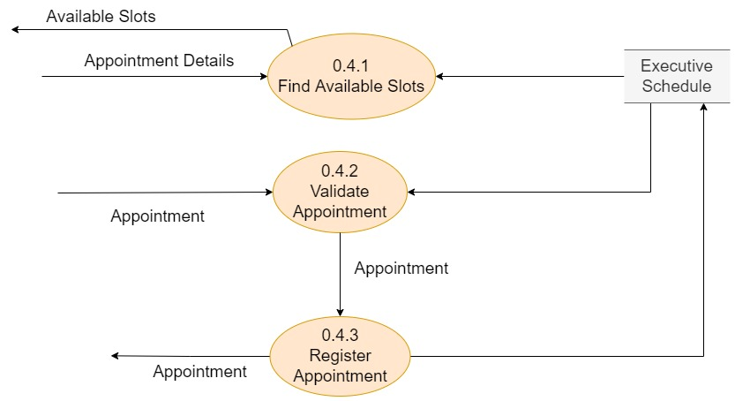
DFD Level-2

Slide 9
Data Definition
Schedule : {Appointment + Leaves}*
Available Slots : {date+time}*
Appointment Data : Appointment + (Appointment Details)
Appointment Details => date+description+participants
Appointment : date+start_time+duration+description+participants
Leaves : date+start_time+duration+description+exID
Executives data : name+contact no+email+password+exID
Updated Schedule : Schedule
Executive Schedule Query : exID+{date}*
Executive Schedule : Schedule
description : string
duration : number
exId : string
name : string
contact : number
email : string
password : string
participants: {exID}*

Slide 10
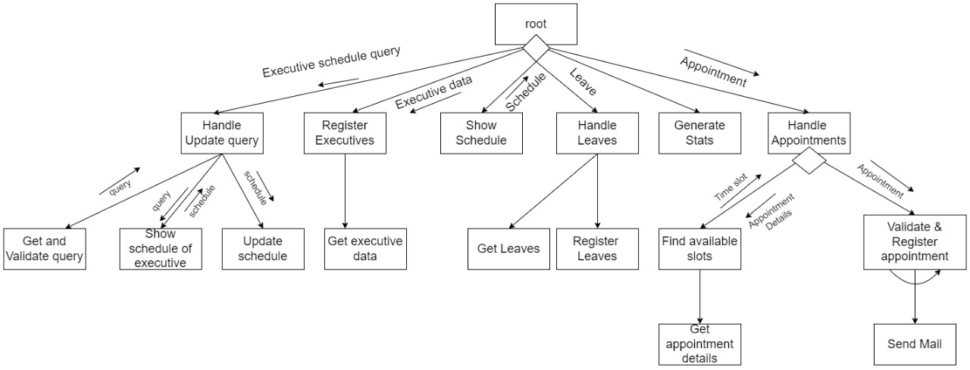
Structure Chart

Slide 11
Pseudocode

Slide 12
Thank You

